Slide 1
네트워크
프로그래밍
03. UDP
CONTENTS
Lab 03 : UDP on Wireshark
휴먼지능정보공학과 201810800
이혜인

Slide 2
Lab 03 : UDP on Wireshark
Instructions
Start capturing packets in Wireshark.
Stop capturing packets.
Questions
Select one UDP packet from your trace. From this packet, determine how many fields there are in the UDP header. Name these fields.
Find out the length (in bytes) of each of the UDP header fields.
The value in the Length field is the length of what? Verify your claim with your captured UDP packet.
What is the maximum number of bytes that can be included in a UDP payload? (Hint: the answer to this question can be determined by your answer to 2. above)
Index

Slide 3
Lab 03 : UDP on Wireshark
Questions
What is the largest possible source port number? (Hint: see the hint in 4.)
What is the protocol number for UDP? Give your answer in both hexadecimal and decimal notation. To answer this question, you’ll need to look into the Protocol field of the IP packet containing this UDP segment.
Examine a pair of UDP packets. (your host sends the first UDP packet and the second UDP packet is a reply to this first UDP packet.) (Hint: for a second packet to be sent in response to a first packet, the sender of the first packet should be the destination of the second packet). Describe the relationship between the port numbers in the two packets.
Index

Slide 4
Index
Lab 03 : UDP on Wireshark

Slide 5
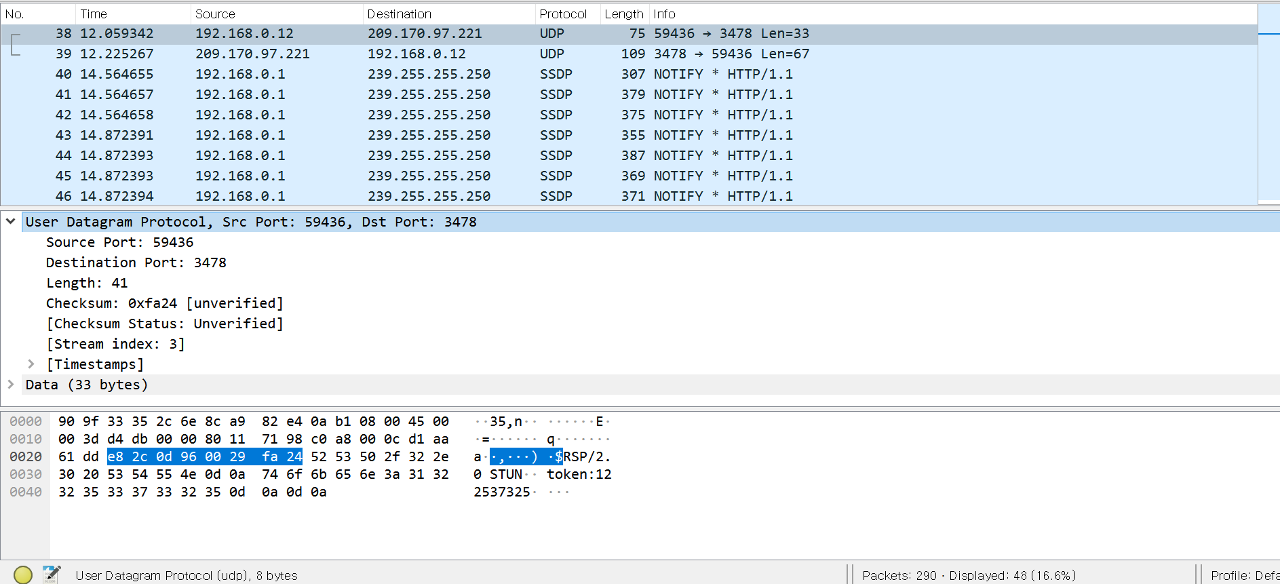
Lab 03 : UDP on Wireshark
Select one UDP packet from your trace. From this packet, determine how many fields there are in the UDP header. Name these fields.
UDP

Slide 6
Lab 03 : UDP on Wireshark
Select one UDP packet from your trace. From this packet, determine how many fields there are in the UDP header. Name these fields.
UDP
UDP Header
Source Port
Destination Port
Length
Checksum
Field (In UDP Header): 4개
Name these fields
  Source Port: 59436
  Destination Port: 3478
  Length: 41
  Checksum: 0xfa24 [unverified]

Slide 7
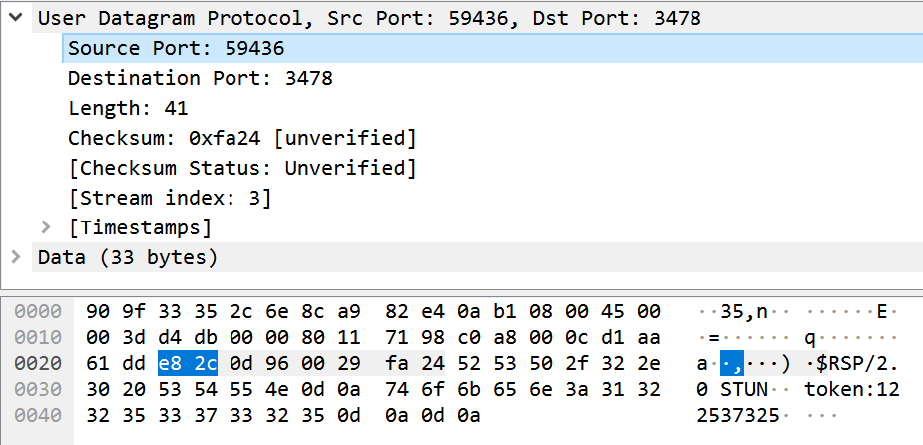

Lab 03 : UDP on Wireshark
Find out the length (in bytes) of each of the UDP header fields.
UDP
Source Port
Destination Port

Slide 8
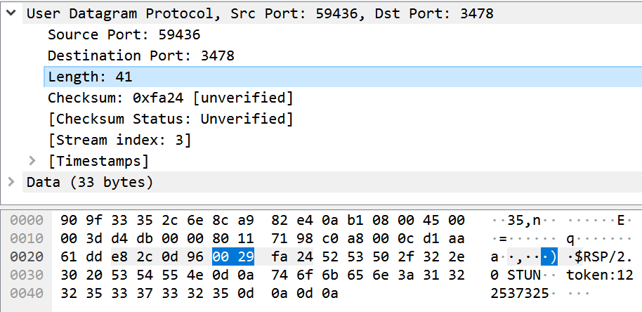
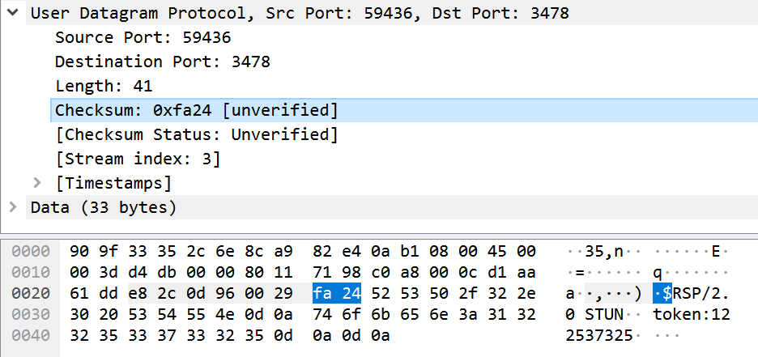
Lab 03 : UDP on Wireshark
Find out the length (in bytes) of each of the UDP header fields.
UDP
Length
Checksum

Slide 9
Lab 03 : UDP on Wireshark
Find out the length (in bytes) of each of the UDP header fields.
UDP
UDP Header(8byte)
Source Port
(2)
Destination Port
(2)
Length
(2)
Checksum
(2)
  Length(in bytes)
    Source Port : 2bytes
    Destination Port : 2bytes
    Length : 2bytes
    Checksum: 2bytes

Slide 10
Lab 03 : UDP on Wireshark
The value in the Length field is the length of what? Verify your claim with your captured UDP packet.
UDP
  Value(In the Length) : 41
  The value in the Length field is the length of what
  → UDP Header(8 bytes) + Remaining Data bytes
  encapsulated in the packet

Slide 11
Lab 03 : UDP on Wireshark
What is the maximum number of bytes that can be included in a UDP payload? (Hint: the answer to this question can be determined by your answer to 2. above)
UDP
The maximum number of bytes
→UDP Packet은 2bytes, 즉 16bits의 Length field로 표현할 수 있다.
그러므로 Packet의 최대크기는 2¹⁶인 65536에서 1을 뺀 65535bytes이다.
이 때, 8bytes는 이미 UDP Header로 사용하고 있다.
따라서 UDP payload의 최대 크기는 UDP Header 8bytes를 제외한
65527bytes이다.

Slide 12
Lab 03 : UDP on Wireshark
What is the largest possible source port number? (Hint: see the hint in 4.)
UDP
The largest possible source port number
→The largest possible source port number is 2¹⁶-1 = 65535 bytes
→UDP Packet은 2bytes, 즉 16bits의 Source Port number field로 표현할 수 있다.
그러므로 Packet의 최대크기는 2¹⁶인 65536bytes에서 1을 뺀 65535bytes이다.

Slide 13
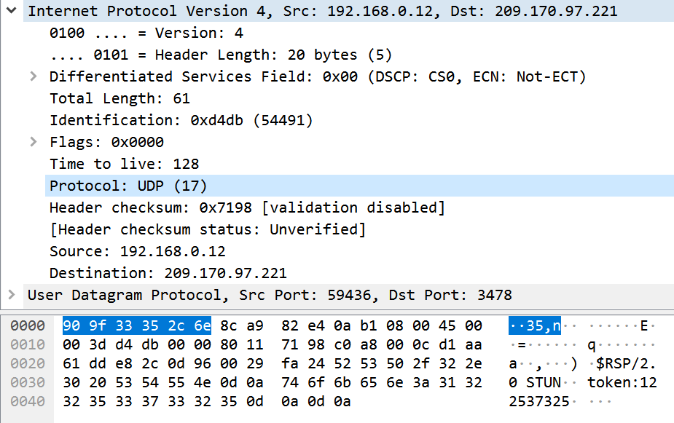
Lab 03 : UDP on Wireshark
What is the protocol number for UDP? Give your answer in both hexadecimal and decimal notation. To answer this question, you’ll need to look into the Protocol field of the IP packet containing this UDP segment.
UDP

Slide 14
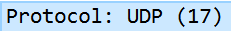
Lab 03 : UDP on Wireshark
What is the protocol number for UDP? Give your answer in both hexadecimal and decimal notation. To answer this question, you’ll need to look into the Protocol field of the IP packet containing this UDP segment.
UDP
The protocol number
→Decimal natation(10진수) : 17
→Hexadecimal natation(16진수) : 0x11

Slide 15
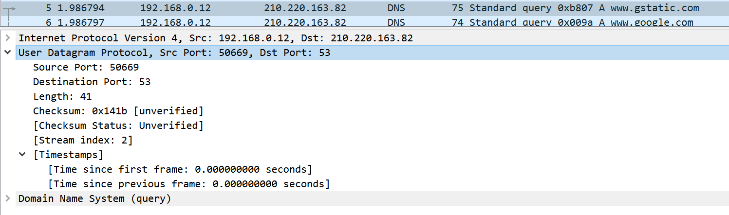
Lab 03 : UDP on Wireshark
Examine a pair of UDP packets. (your host sends the first UDP packet and the second UDP packet is a reply to this first UDP packet.) (Hint: for a second packet to be sent in response to a first packet, the sender of the first packet should be the destination of the second packet). Describe the relationship between the port numbers in the two packets.
UDP
→First UDP Packet(전송된 Packet)
  Source Port : 50669
  Destination Port : 53

Slide 16
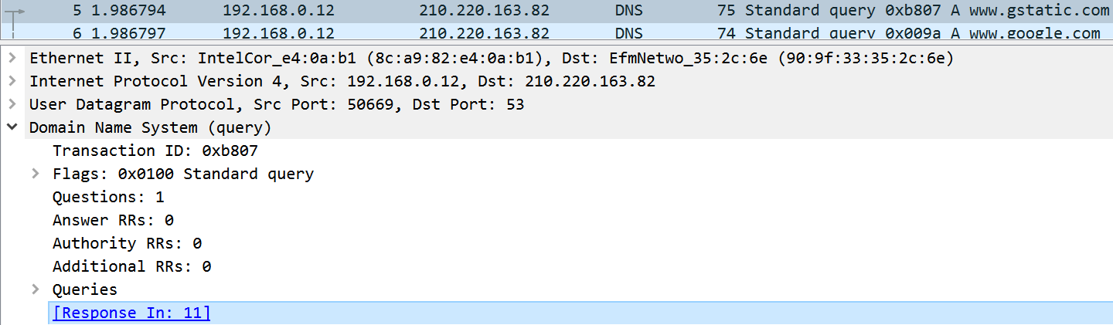
Lab 03 : UDP on Wireshark
Examine a pair of UDP packets. (your host sends the first UDP packet and the second UDP packet is a reply to this first UDP packet.) (Hint: for a second packet to be sent in response to a first packet, the sender of the first packet should be the destination of the second packet). Describe the relationship between the port numbers in the two packets.
UDP
→First UDP Packet의 Response인 Second UDP Packet은 11번이다.

Slide 17
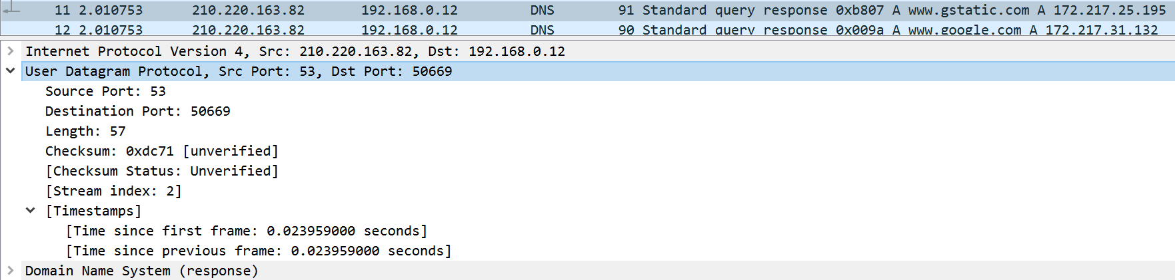
Lab 03 : UDP on Wireshark
Examine a pair of UDP packets. (your host sends the first UDP packet and the second UDP packet is a reply to this first UDP packet.) (Hint: for a second packet to be sent in response to a first packet, the sender of the first packet should be the destination of the second packet). Describe the relationship between the port numbers in the two packets.
UDP
→Second UDP Packet(응답된 Packet)
  Source Port : 53
  Destination Port : 50669

Slide 18


Lab 03 : UDP on Wireshark
Examine a pair of UDP packets. (your host sends the first UDP packet and the second UDP packet is a reply to this first UDP packet.) (Hint: for a second packet to be sent in response to a first packet, the sender of the first packet should be the destination of the second packet). Describe the relationship between the port numbers in the two packets.
UDP
First Packet인 전송된 Packet의 Port 번호와 Second Packet인 응답된 Port 번호 간의 관계
전송된 Packet의 Source Port가 응답된 Packet의 Destination Port가 되고,
전송된 Packet의 Destination Port가 응답된 Packet의 Source Port가 되는 관계가 있다.
→First UDP Packet(전송된 Packet)
→Second UDP Packet(응답된 Packet)
이를 보면 두 Packet의 Port 번호 간의 관계를 알 수 있다.

